Slide 1
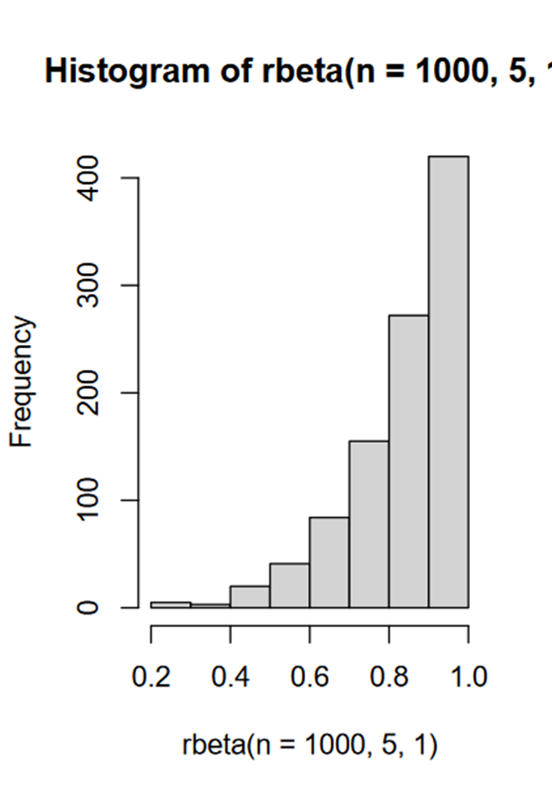
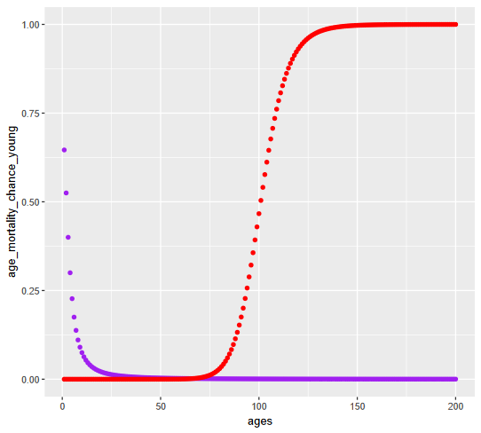
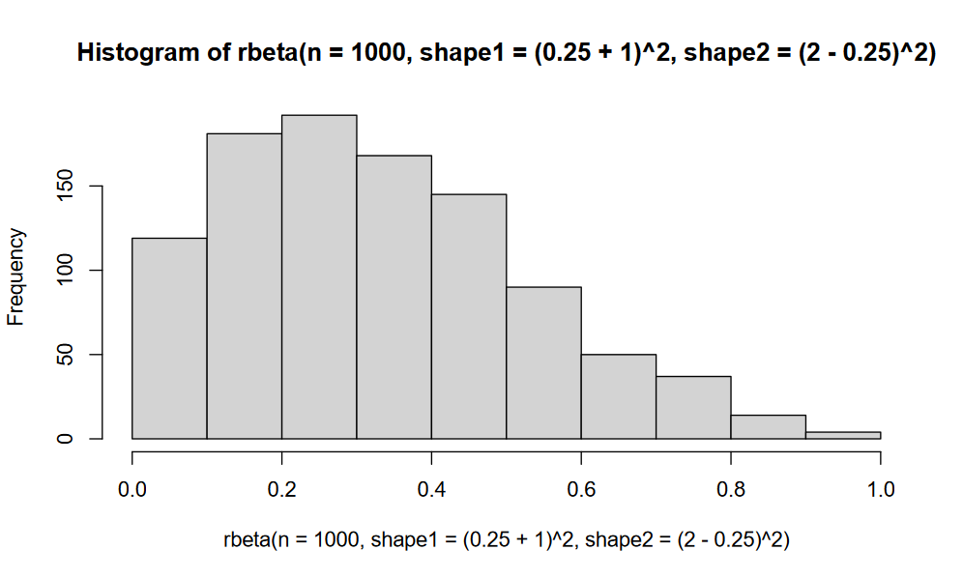
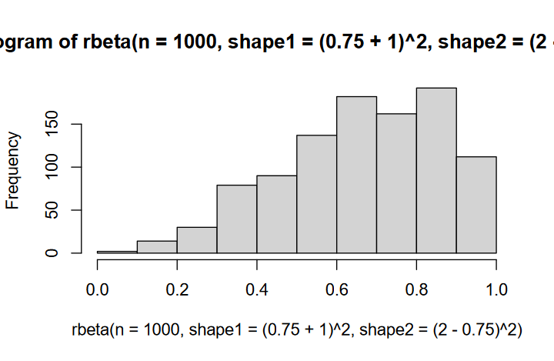
Starting population
Does a disturbance occur?
Disturbance – disturbance_event_chance.R
disturbance_size <- 1-disturbance_size_chance
No change to pre-set values
‘Complex’
Disturbance shifts by age?
‘Flat’
Calculates age differential impact (higher for seedlings) – 0-1 score
Changes age, MR and recruitment score by this (1+dist val)
Changes age, MR and recruitment score by a flat (1+dist val)
Dead individual list
Recruited individual list -
recruitment_functions_3.R
If MR mortality is introduced late & the time point is after the introduction time - mortality_functions_MRintro_hill.R
If MR mortality is constant or the time point is before the MR introduction time - mortality_functions_hill.R
Adjust recruitment constant?
If population < minimum pop size
Recruitment constant x 10
Density recruitment toggle – if so, changes recruitment constant based on pop size
Changes MR chance accordingly
Calculate number of fecund individuals and
their chance of recruitment given age + MR status
Individuals >= recruitment_age
Reduce intervention individual’s mortality chance if toggle on
Two hill equation with varying direction + steepness depending that changes at mortality_age_shiftch
Calculate age mortality
If they recruit calculate how many seedlings recruited
rnorm(n=sum(indiv_recruitment), mean = recruitment_size_mean, sd = recruitment_size_sd)
MR_chance <- (1 / (1 + (ages / MR_age_impact_val))) * MR * MR_death_impact_val
Age x MR interaction toggle on?
For each recruited individual calculate MR status depending on parent’s MR status
rbeta( shape1=parent_MR+1)^2, shape2=(2- parent_MR)^2)
Calculate final change of mortality using a
conditional probability
Append to ‘recruited population’ give all individuals
a mortality of 0 for time point
comp_chance = (pop_size - population_capacity)/population_capacity * (1+comp_impact_val)
If population is larger than max carrying capacity,:
raise minimum chance of mortality
Determine weighted chance mortality outcome for all individuals
Add intervention individuals
User set number of individuals and time point introduced
MR determined by rnorm using pre-set mean and SD
Combine
End population
Notes:
Hard line = link
Dashed line = operations of functions
Dotted line = multiple pathways
Red = function
Green = outcome

Slide 2
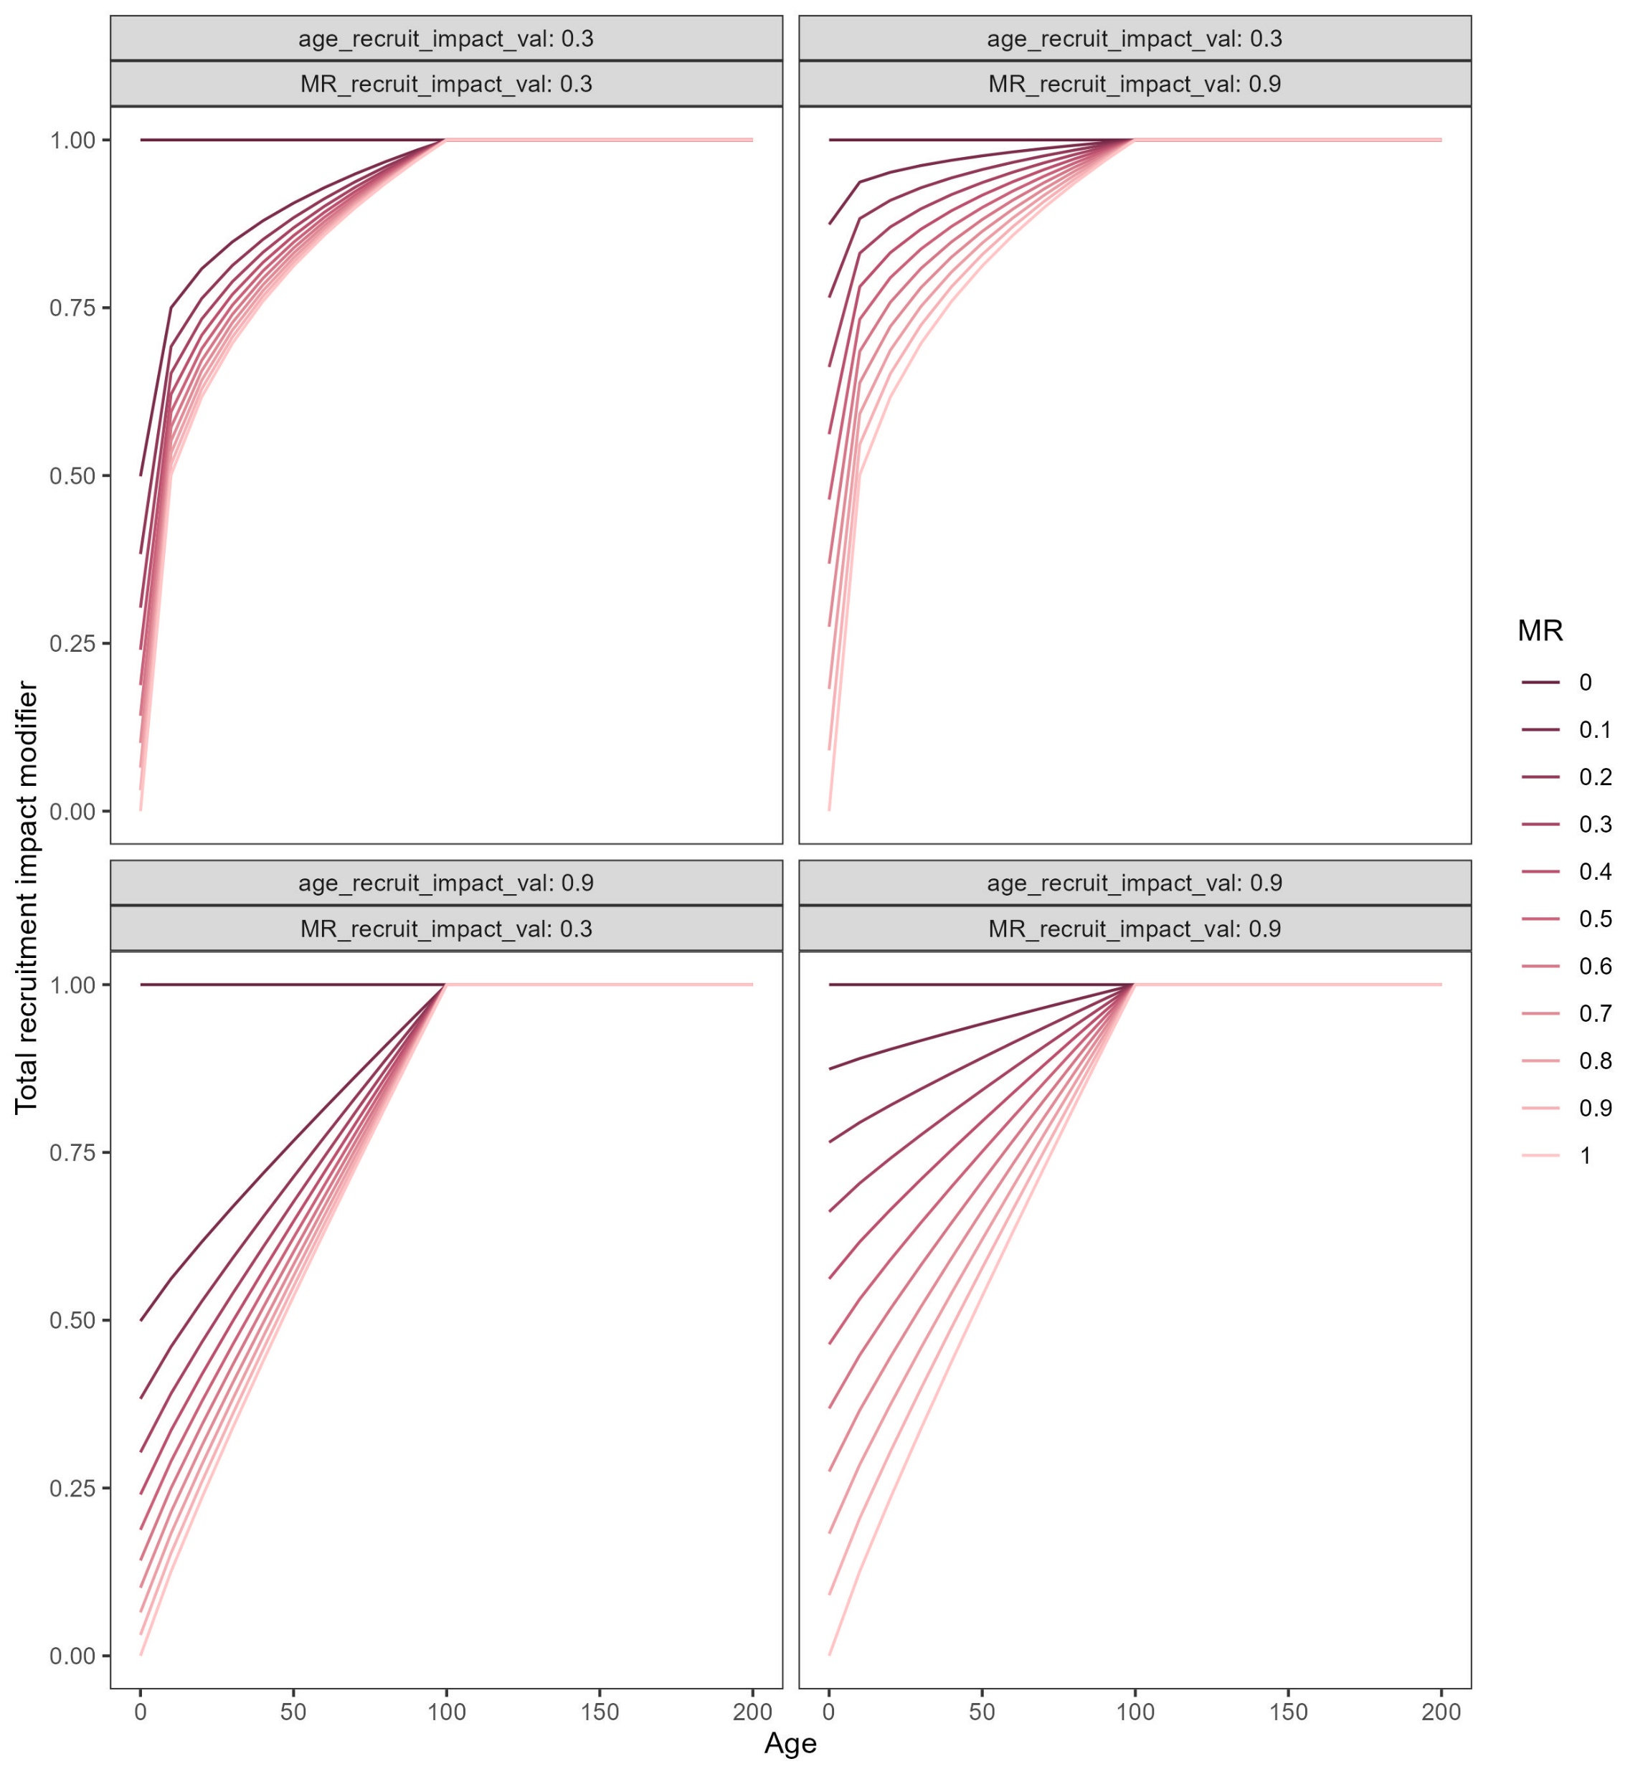
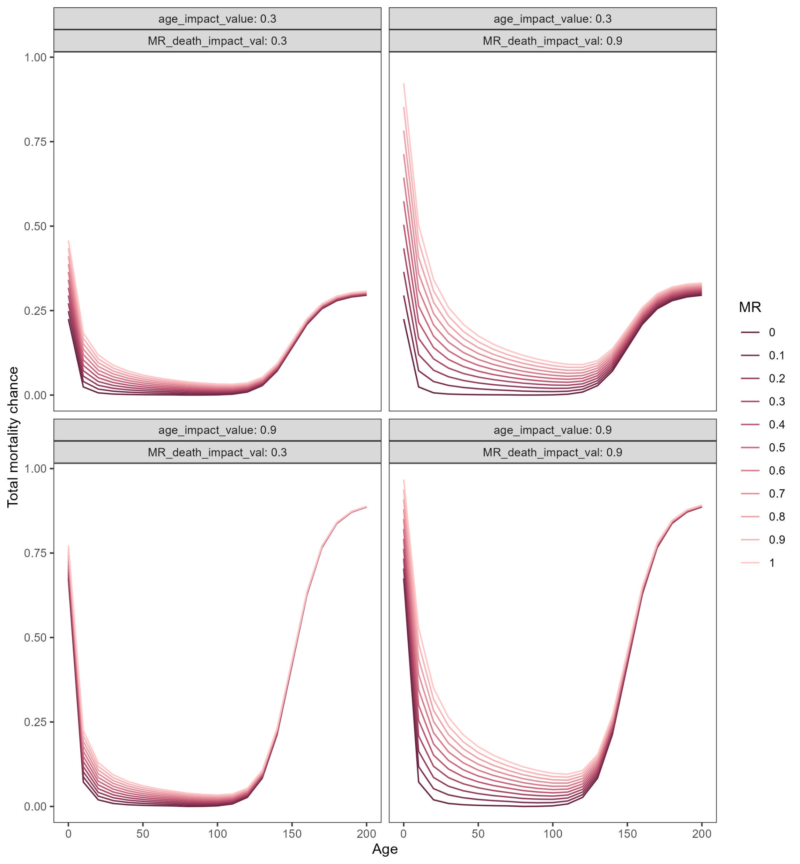
Starting population
Does a disturbance occur?
Disturbance – disturbance_event_chance.R
disturbance_size <- 1-disturbance_size_chance
No change to pre-set values
‘Complex’
Disturbance shifts by age?
‘Flat’
Recruited individual list -
recruitment_functions_3.R
Calculates age differential impact (higher for seedlings) – 0-1 score
Changes age, MR and recruitment score by this (1+dist val)
Changes age, MR and recruitment score by a flat (1+dist val)
Recruitment constant x 10
If population < minimum pop size
Adjust recruitment constant?
Density recruitment toggle – if so, changes recruitment constant based on pop size
Calculate number of fecund individuals and
their chance of recruitment given age + MR status
Individuals >= recruitment_age
If they recruit calculate how many seedlings recruited
rnorm(n=sum(indiv_recruitment), mean = recruitment_size_mean, sd = recruitment_size_sd)
For each recruited individual calculate MR status depending on parent’s MR status
rbeta( shape1=parent_MR+1)^2, shape2=(2- parent_MR)^2)
Append to ‘recruited population’ give all individuals
a mortality of 0 for time point
Add intervention individuals
User set number of individuals and time point introduced
MR determined by rnorm using pre-set mean and SD
Dead individual list
If MR mortality is introduced late & the time point is after the introduction time - mortality_functions_MRintro_hill.R
If MR mortality is constant or the time point is before the MR introduction time - mortality_functions_hill.R
Changes MR chance accordingly
Reduce intervention individual’s mortality chance if toggle on
Two hill equation with varying direction + steepness depending that changes at mortality_age_shiftch
Calculate age mortality
MR_chance <- (1 / (1 + (ages / MR_age_impact_val))) * MR * MR_death_impact_val
Age x MR interaction toggle on?
Calculate final change of mortality using a
conditional probability
comp_chance = (pop_size - population_capacity)/population_capacity * (1+comp_impact_val)
If population is larger than max carrying capacity,:
raise minimum chance of mortality
Determine weighted chance mortality outcome for all individuals
End population

